Slide 1

JavaScript
*Your definition of fun may differ from the lecturer’s…
Where the fun starts! *

Slide 2
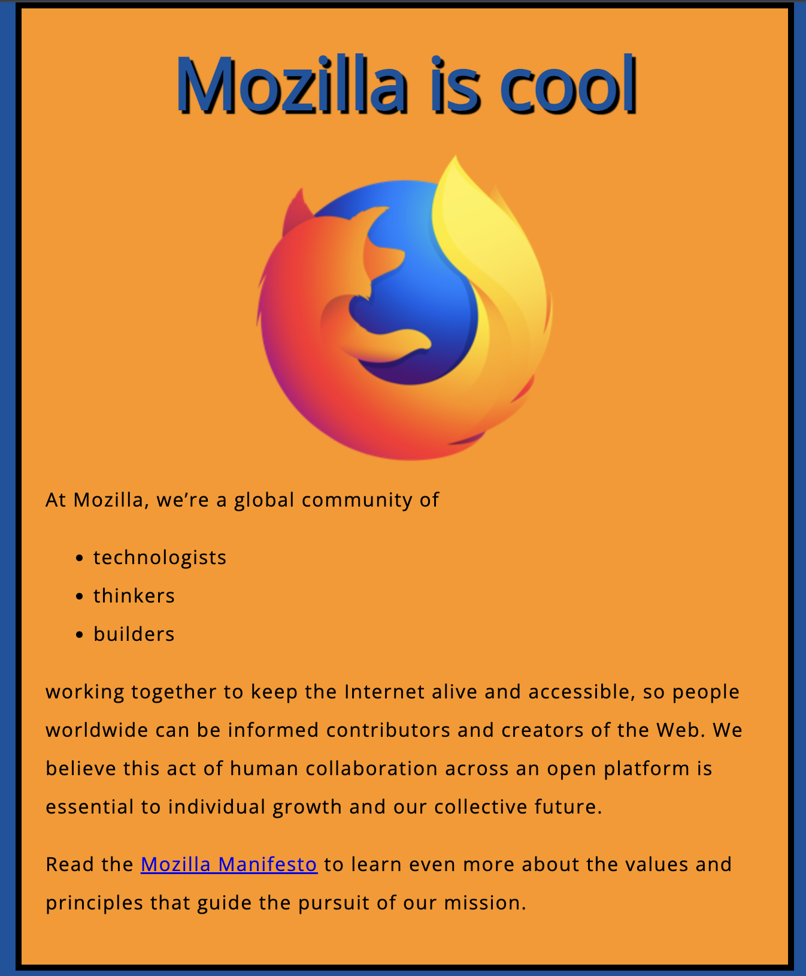
<!DOCTYPE html>
<html lang="en">
<head>
<meta charset="utf-8">
<title>My test page</title>
<link href="http://fonts.googleapis.com/css?family=Open+Sans" rel="stylesheet" type="text/css">
<link href="styles/style.css" rel="stylesheet" type="text/css">
</head>
<body>
<h1 id="heading">Mozilla is cool</h1>
<img src="images/firefox-icon.png" alt="The Firefox logo: a flaming fox surrounding the Earth.">
<p>At Mozilla, we’re a global community of</p>
<ul> <!-- changed to list in the tutorial -->
<li>technologists</li>
<li>thinkers</li>
<li>builders</li>
</ul>
<p>working together to keep the Internet alive and accessible, so people worldwide can be informed contributors and creators of the Web. We believe this act of human collaboration across an open platform is essential to individual growth and our collective future.</p>
<p>Read the <a href="https://www.mozilla.org/en-US/about/manifesto/">Mozilla Manifesto</a> to learn even more about the values and principles that guide the pursuit of our mission.</p>
</body>
</html>

Slide 3
<!DOCTYPE html>
<html lang="en">
<head>
<meta charset="utf-8">
<title>My test page</title>
<link href="http://fonts.googleapis.com/css?family=Open+Sans" rel="stylesheet" type="text/css">
<link href="styles/style.css" rel="stylesheet" type="text/css">
</head>
<body>
<h1 id="heading">Mozilla is cool</h1>
<img src="images/firefox-icon.png" alt="The Firefox logo: a flaming fox surrounding the Earth.">
<p>At Mozilla, we’re a global community of</p>
<ul> <!-- changed to list in the tutorial -->
<li>technologists</li>
<li>thinkers</li>
<li>builders</li>
</ul>
<p>working together to keep the Internet alive and accessible, so people worldwide can be informed contributors and creators of the Web. We believe this act of human collaboration across an open platform is essential to individual growth and our collective future.</p>
<p>Read the <a href="https://www.mozilla.org/en-US/about/manifesto/">Mozilla Manifesto</a> to learn even more about the values and principles that guide the pursuit of our mission.</p>
</body>
</html>
https://codeload.github.com/mdn/beginner-html-site-styled/zip/refs/heads/gh-pages
<!-- https://codeload.github.com/mdn/beginner-html-site-styled/zip/refs/heads/gh-pages -->

Slide 4
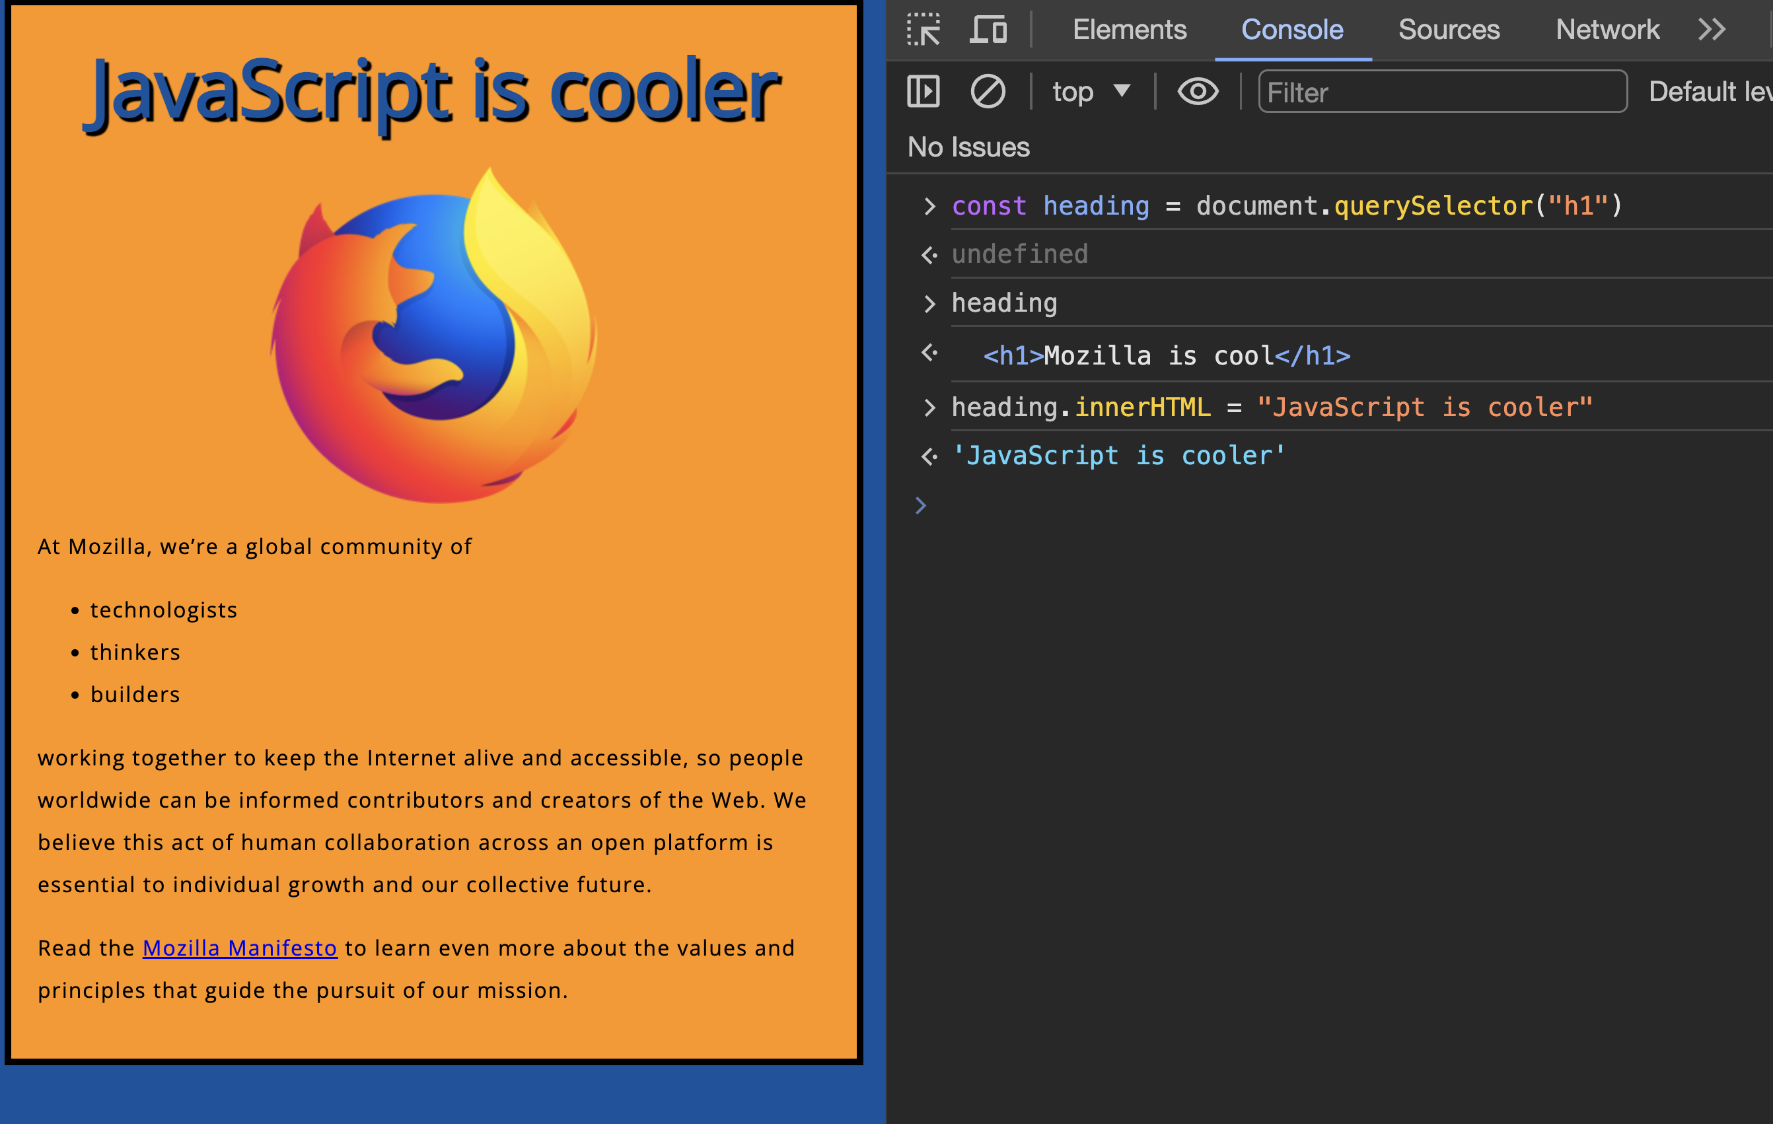

Slide 5
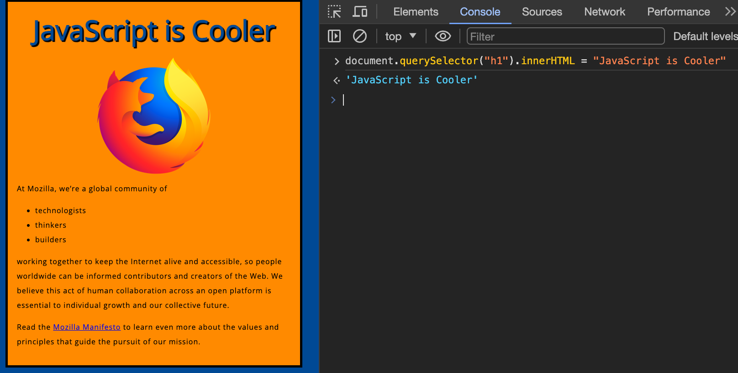
document.querySelector("h1").innerHTML = "JavaScript is Cooler";

Slide 6
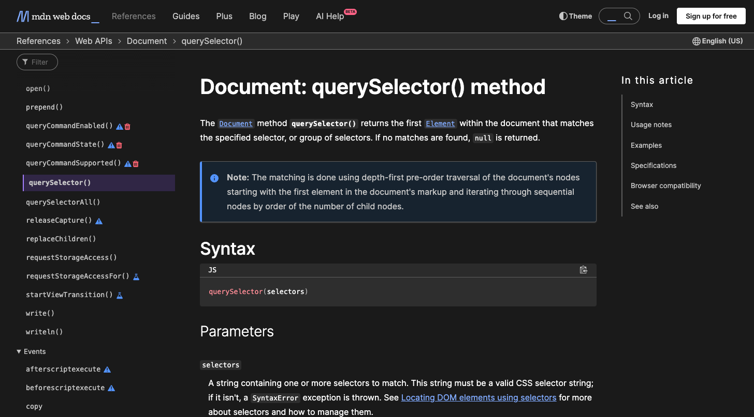
document.querySelector("h1").innerHTML = "JavaScript is Cooler";
https://developer.mozilla.org/en-US/docs/Web/API/Document/querySelector

Slide 7
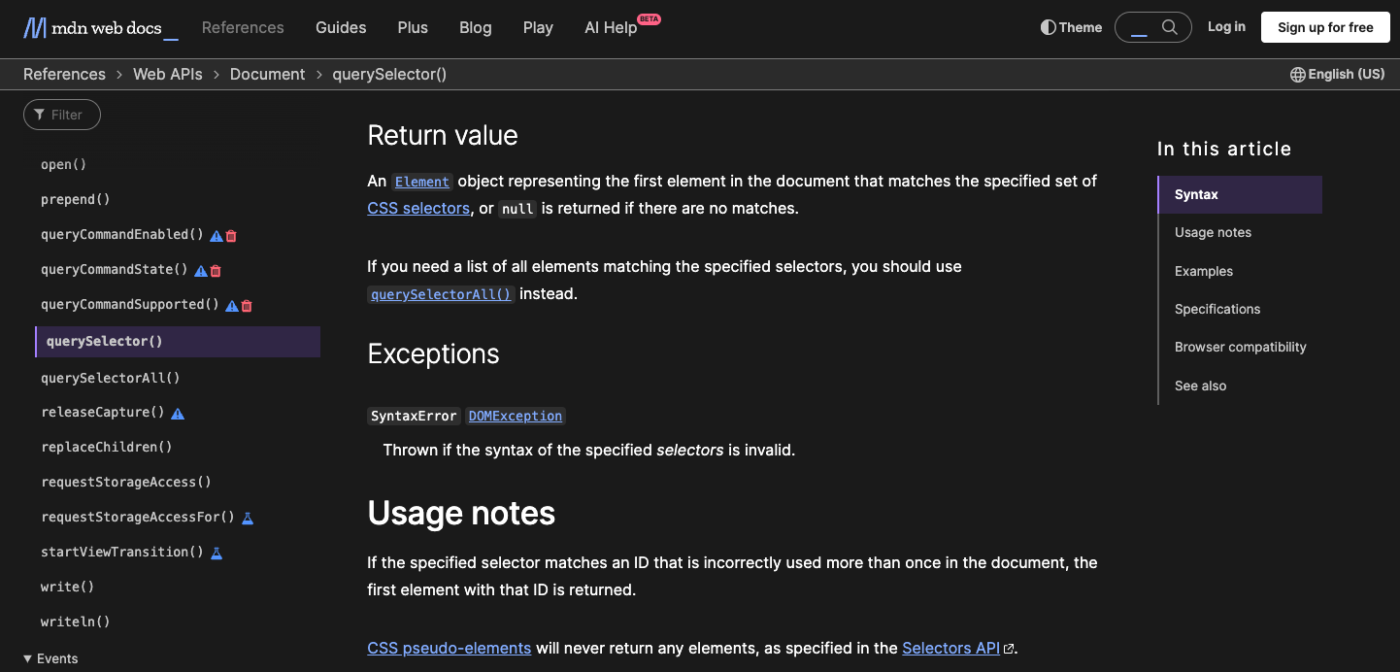
document.querySelector("h1").innerHTML = "JavaScript is Cooler";
https://developer.mozilla.org/en-US/docs/Web/API/Document/querySelector

Slide 8
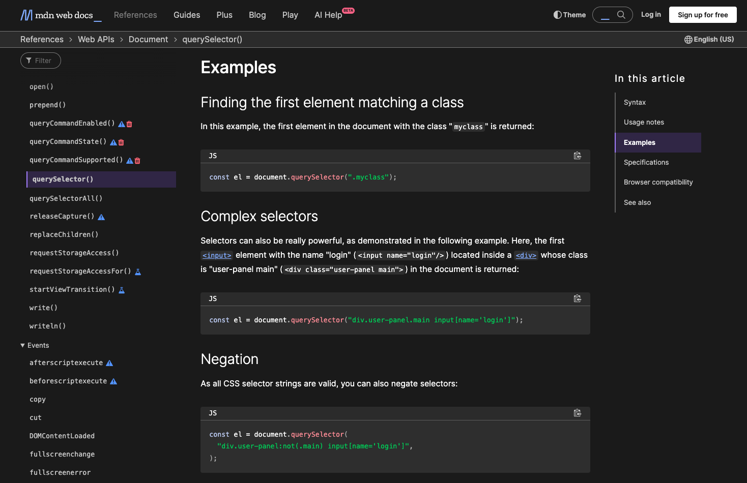
document.querySelector("h1").innerHTML = "JavaScript is Cooler";
https://developer.mozilla.org/en-US/docs/Web/API/Document/querySelector

Slide 9
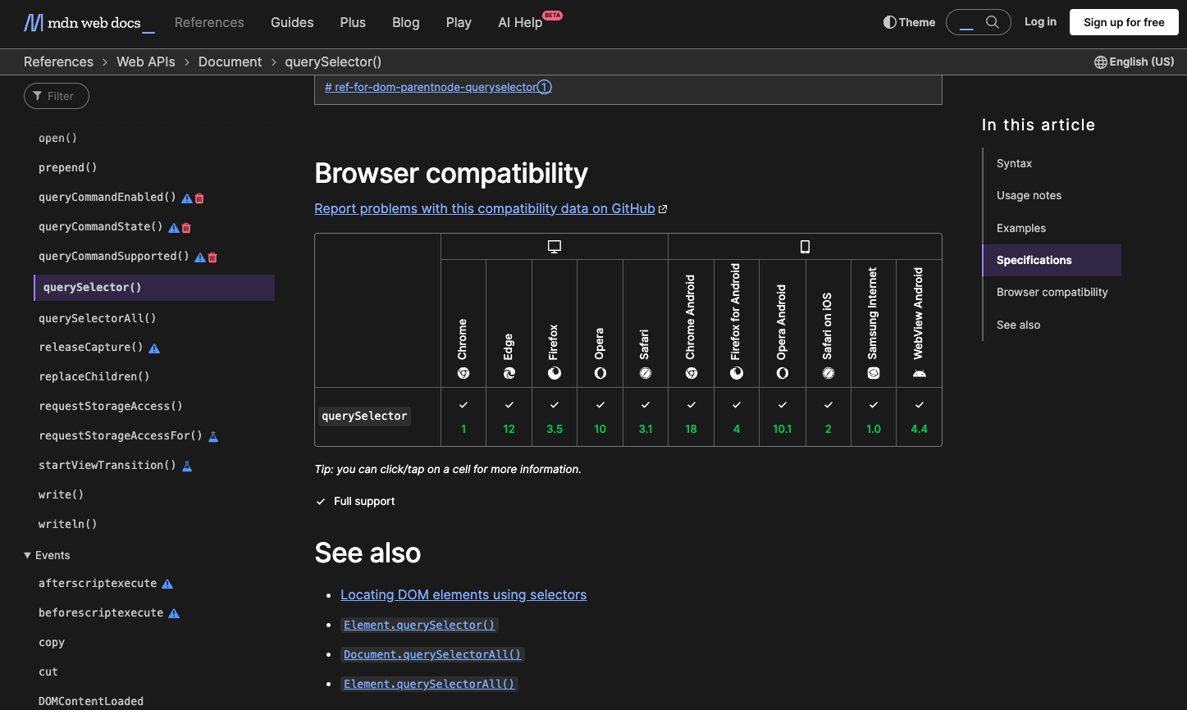
document.querySelector("h1").innerHTML = "JavaScript is Cooler";
https://developer.mozilla.org/en-US/docs/Web/API/Document/querySelector

Slide 10
Try it yourself https://codeload.github.com/mdn/beginner-html-site-styled/zip/refs/heads/gh-pages
https://developer.mozilla.org/en-US/docs/Web/API/Document/querySelector

Slide 11
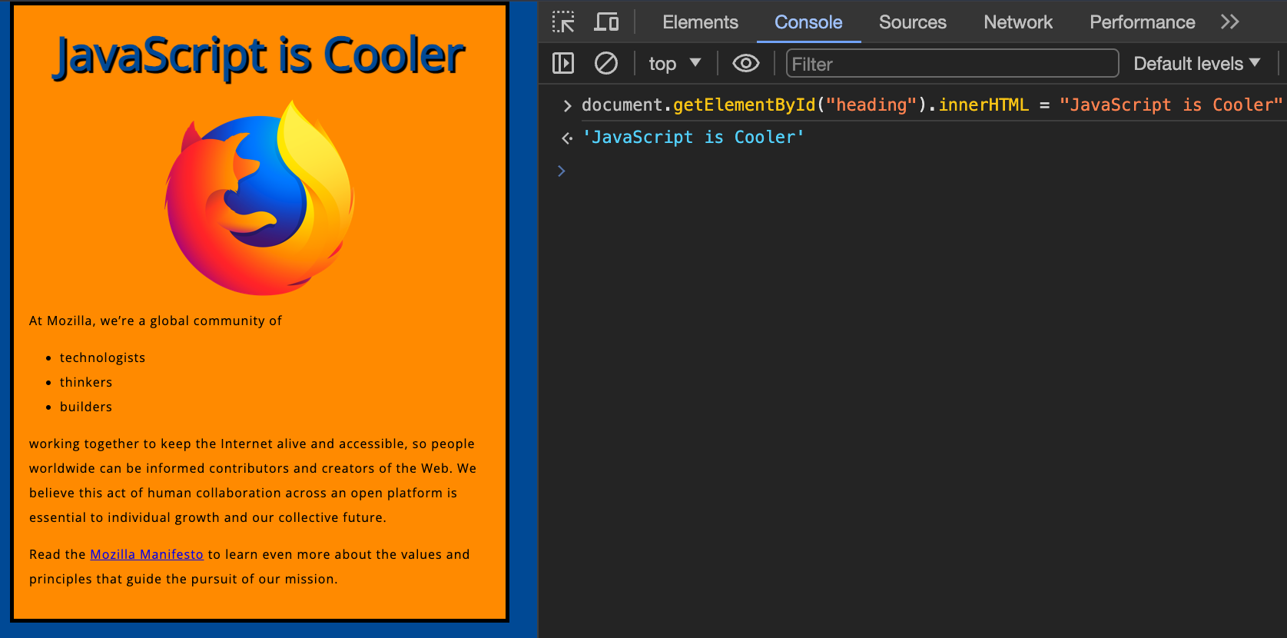
<h1 id="heading">Mozilla is cool</h1>
https://developer.mozilla.org/en-US/docs/Web/API/Document/getElementById

Slide 12
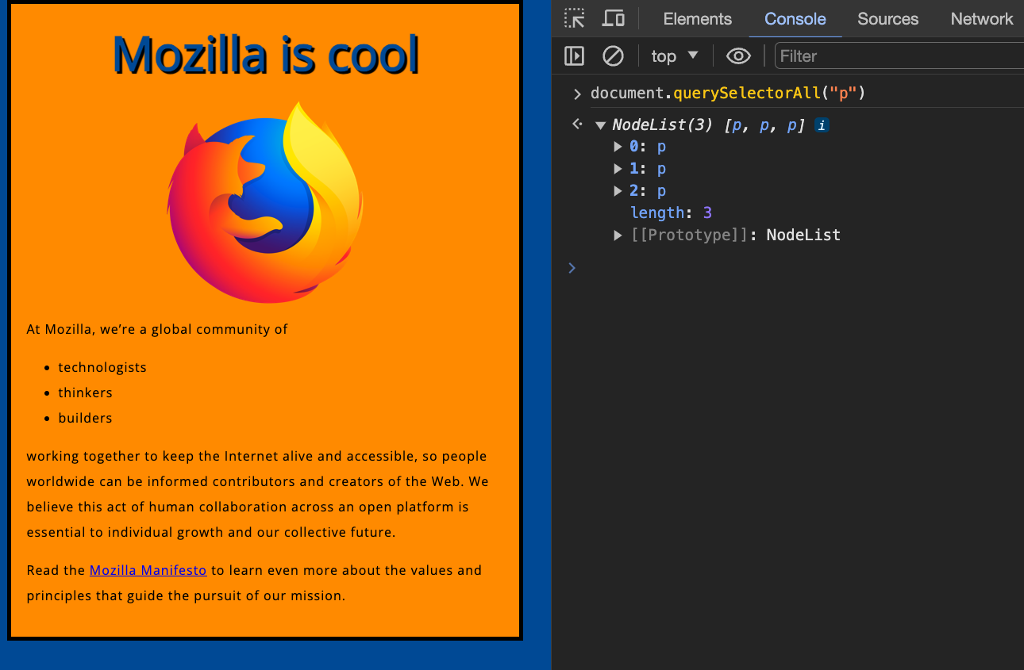
https://developer.mozilla.org/en-US/docs/Web/API/Document/querySelectorAll

Slide 13
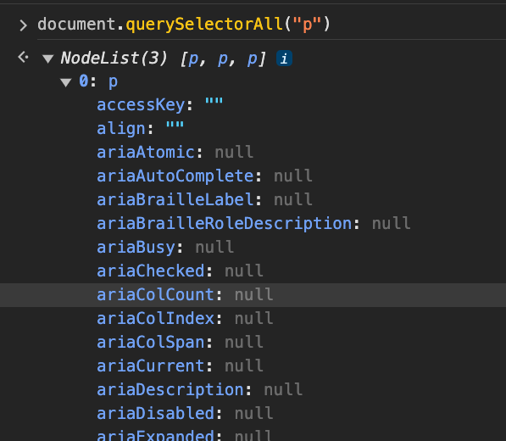
https://developer.mozilla.org/en-US/docs/Web/API/Document/querySelectorAll

Slide 14
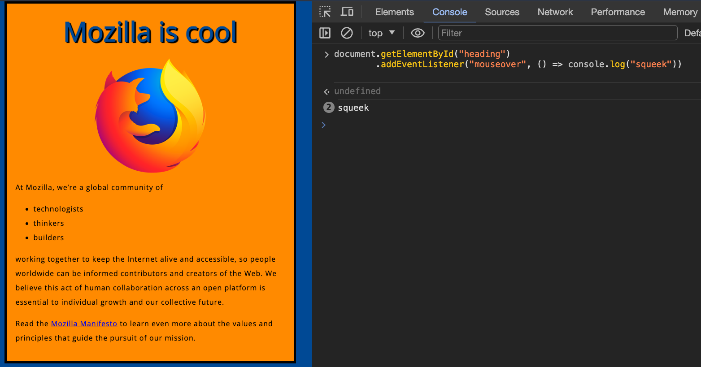
https://developer.mozilla.org/en-US/docs/Web/API/Element/mouseover_event

Slide 15
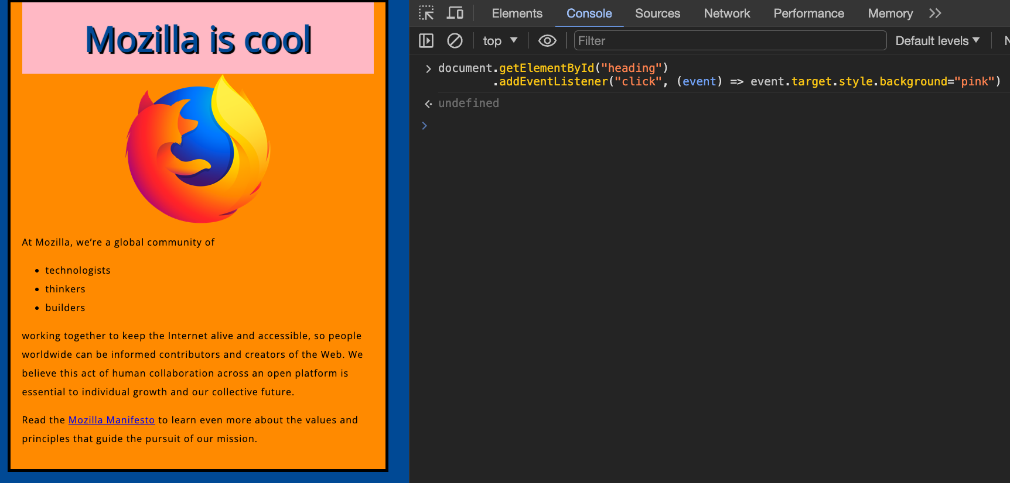
https://developer.mozilla.org/en-US/docs/Web/API/Element/click_event

Slide 16

What did we just see????????

Slide 17
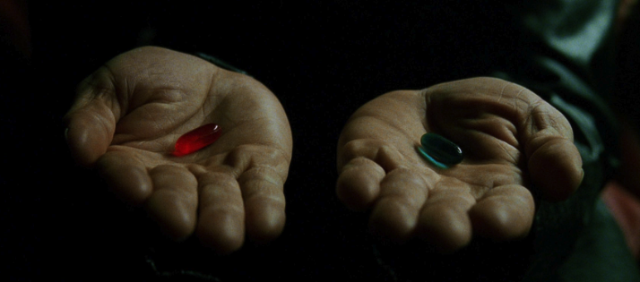
What did we just see?
We opened our Dev Tools and Selected the JavaScript Console
We changed the inner HTML of the heading (h1) element
document.querySelector("h1").innerHTML = "JavaScript is Cooler";
This is an example of changing the content of our page using JavaScript
Then we attached multiple event listeners to our heading (h1) element
document.getElementById("heading")
.addEventListener("mouseover", () => console.log("squeek"))
.addEventListener("click", (event) => event.target.style.background = "pink")
This is an example of responding to user input, either directly or indirectly
All of this is client-side, browser-based JavaScript
We are manipulating the DOM or Document Object Model
We will cover all these examples in detail in the coming lectures
But for now……..

Slide 18

Step Back

Slide 19
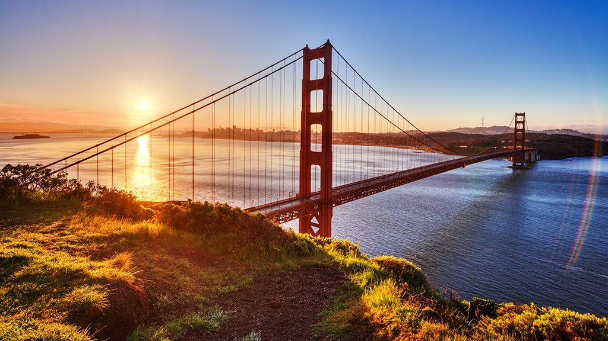
HTML defines the Structure of your Web Page

Slide 20

CSS is responsible for the Presentation and Styling of that Structure

Slide 21
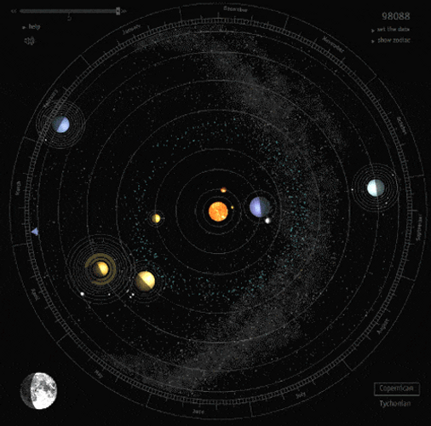
JavaScript adds Behaviour and Dynamism to your Web Page

Slide 22

JavaScript is a programming language that adds interactivity to your website.
This happens in games, in the behaviour of responses when buttons are pressed or with data entry on forms; with dynamic styling; with animation, etc.

Slide 23
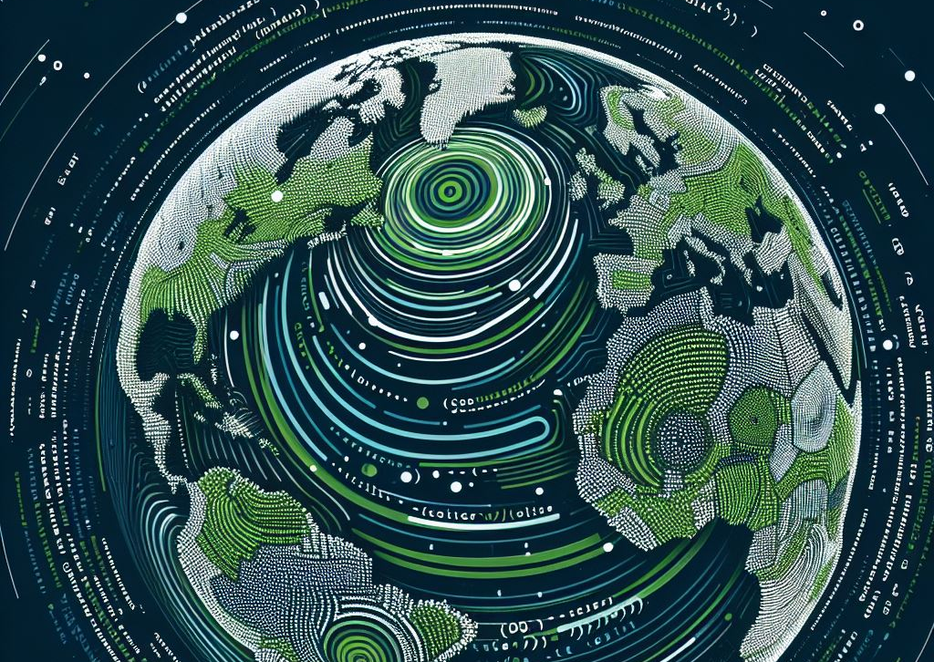
JavaScript is a powerful programming language that can add interactivity to a website. It was invented by Brendan Eich.
It is versatile and beginner-friendly.
With more experience, you'll be able to create games, animated 2D and 3D graphics, comprehensive database-driven apps, and much more!

Slide 24
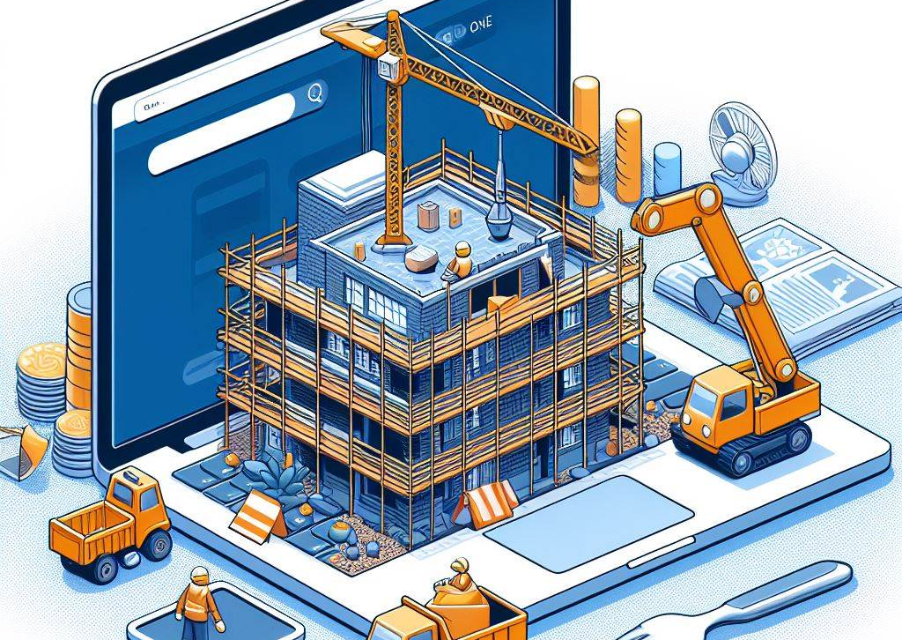
JavaScript itself is relatively compact, yet very flexible.
Developers have written a variety of tools on top of the core JavaScript language, unlocking a vast amount of functionality with minimum effort. These include:
Browser Application Programming Interfaces (APIs) built into web browsers, providing functionality such as dynamically creating HTML and setting CSS styles; collecting and manipulating a video stream from a user's webcam, or generating 3D graphics and audio samples.
Third-party APIs that allow developers to incorporate functionality in sites from other content providers, such as X or Facebook.
Third-party frameworks and libraries that you can apply to HTML to accelerate the work of building sites and applications.

Slide 25

Let’s focus in on Browser Application Programming Interfaces (APIs)

Slide 26

Client-side web APIs
When writing client-side JavaScript for websites or applications, you will quickly encounter Application Programming Interfaces (APIs).
APIs are programming features for manipulating different aspects of the browser and operating system the site is running on, or manipulating data from other websites or services.
https://developer.mozilla.org/en-US/docs/Learn/JavaScript/Client-side_web_APIs

Slide 27
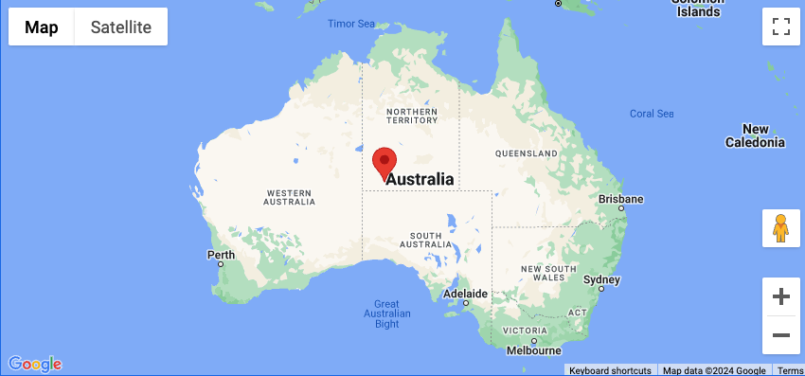
What is an API?
const map = new Map(document.getElementById("map"), {
zoom: 4,
center: position,
mapId: "DEMO_MAP_ID",
});
// The marker, positioned at Uluru
const marker = new AdvancedMarkerElement({
map: map,
position: position,
title: "Uluru",
});
Application Programming Interfaces (APIs) are constructs made available in programming languages to allow developers to create complex functionality more easily.
APIs abstract more complex code away from you, providing some easier syntax to use in its place.

Slide 28
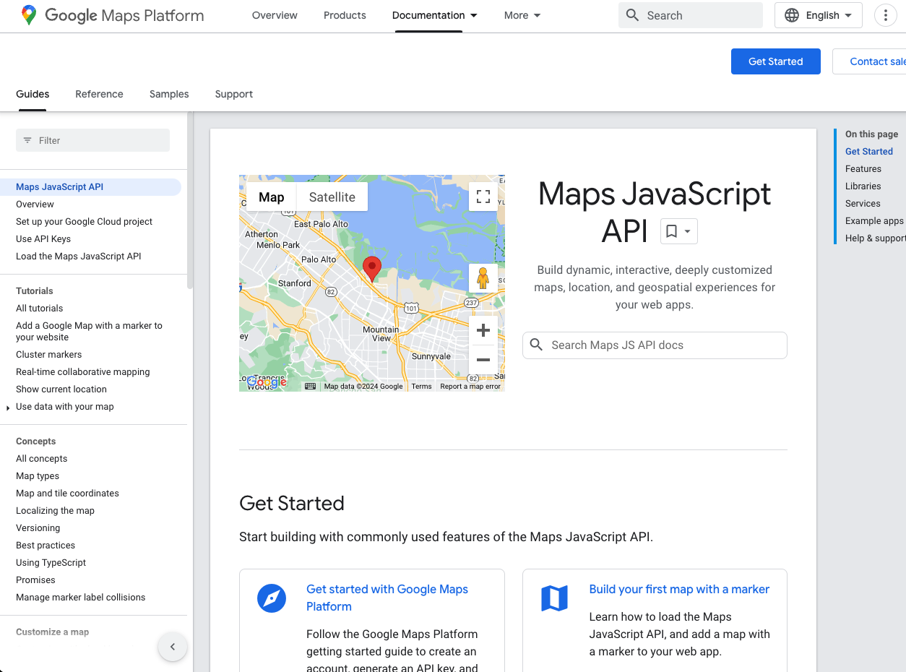

Slide 29

I thought an API was a Web Service or REST Endpoint?
API can be used to describe :
A software ”package” that simplifies or enables a specific task, service or feature
Google Maps API
Twilio API
Browser Document Object Model
The Fetch API to retrieve data from the web
Connect to a database from your java code
A HTTP based Web Service or REST API
These are API’s hosted on the internet (or a private network)
Typically accessed via URLs or “endpoints”
Follow a particular protocol (usually HTTP) with a specific spec or set of principal, e.g. REST, SOAP or proprietary
We will talk more about these in Web Dev II
You will come across more uses of the term API

Slide 30
Browser APIs – DOM (Document Object Model) API
Allows you to manipulate HTML and CSS — creating, removing and changing HTML, dynamically applying new styles to your page, etc.
Every time you see a popup window appear on a page or some new content displayed, for example, that's the DOM in action

Slide 31
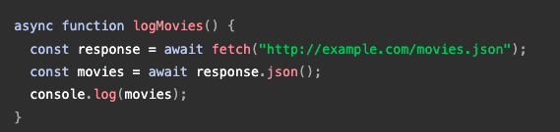
Browser APIs – Fetch API
APIs that fetch data from the server to update small sections of a webpage on their own are very commonly used.
This seemingly small detail has had a huge impact on the performance and behaviour of sites — if you just need to update a stock listing or list of available new stories, doing it instantly without having to reload the whole entire page from the server can make the site or app feel much more responsive and "snappy".
The main API used for this is the Fetch API

Slide 32
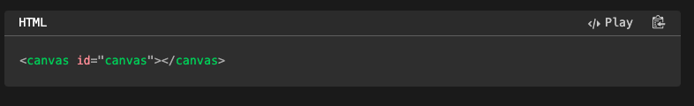
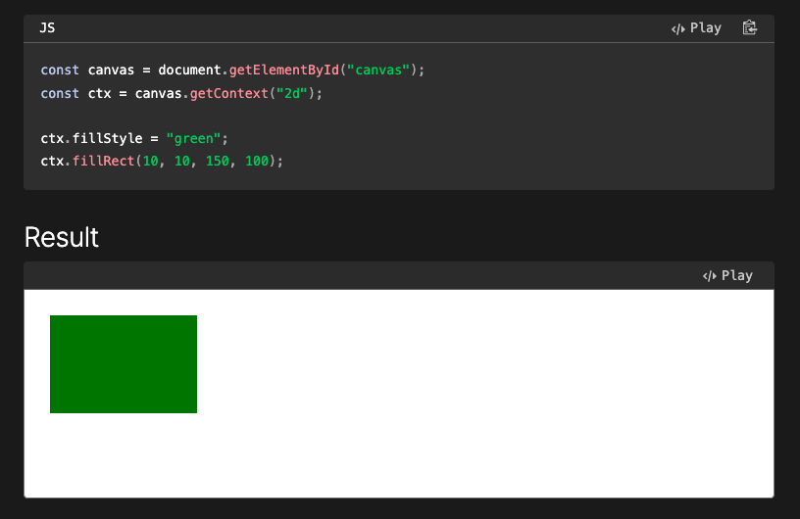
Browser APIs - Canvas
APIs for drawing and manipulating graphics are widely supported in browsers — the most popular ones are Canvas and WebGL, which allow you to programmatically update the pixel data contained in an HTML <canvas> element to create 2D and 3D scenes.
For example, you might draw shapes such as rectangles or circles, import an image onto the canvas, and apply a filter to it such as sepia or grayscale using the Canvas API.

Slide 33
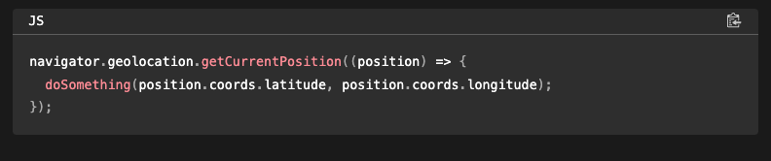
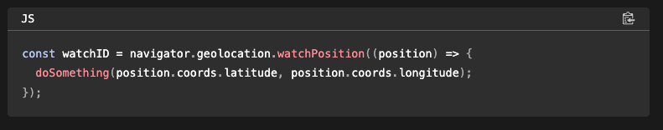
Browser APIs - Geolocation
Device APIs enable you to interact with device hardware: for example, accessing the device GPS to find the user's position using the Geolocation API.

Slide 34
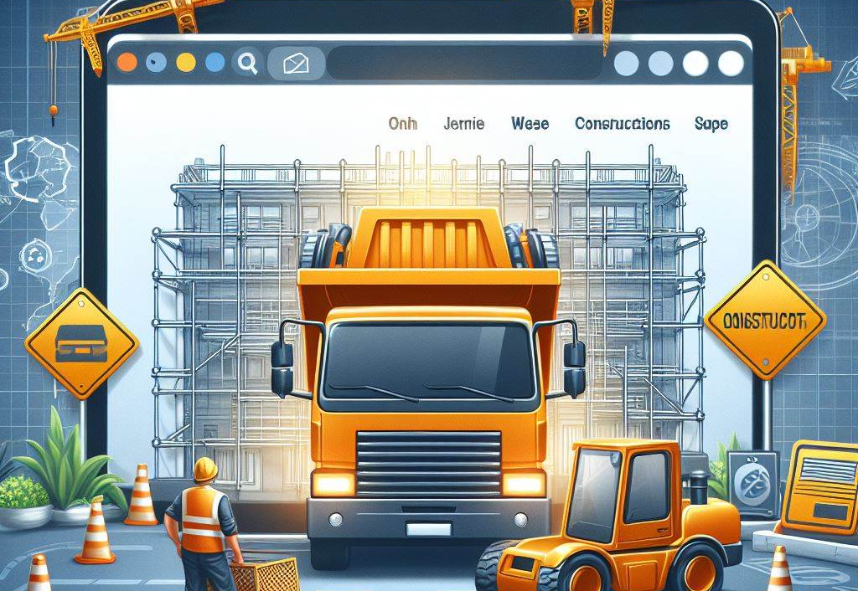
We interact with all these APIs with JavaScript
Let’s dive into that in the next section
For more information on Browser APIs ➔ MDN

